Slide 1
Distributed Systems CS 15-440
Introduction
Lecture 1, July 31, 2022
Mohammad Hammoud

Slide 2

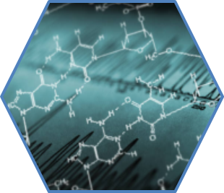
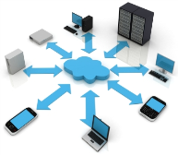
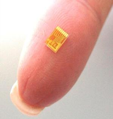
On the Verge of A Disruptive Century : Breakthroughs
Deepest Infrared Image of Universe
Delivered by NASA’s JWST
Astronomy
Ubiquitous Computing
Smaller, Faster, Cheaper Sensors
Gene Sequencing and Biotechnology

Slide 3

A Common Theme is Data
The amount of data is only growing… 1.2 Zettabytes (10²¹ B or 1 Billion TB)

Slide 4
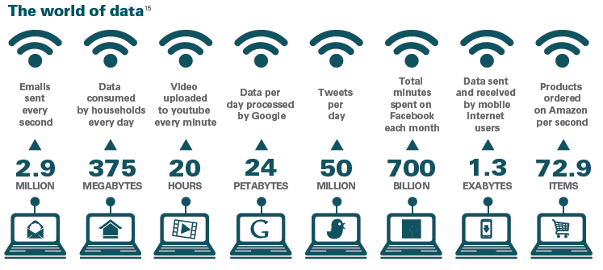
We Live in a World of Data…

Slide 5
What Do We Do With Data?
Store
Access
Encrypt
…. and more!
Process
Share
We want to do these seamlessly...

Slide 6








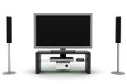

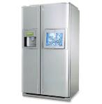
Using Diverse Interfaces & Devices
Mobile Devices
Computers
…and even appliances
Consumer Electronics
Personal Monitors and Sensors
We also want to access, share and process our data from all of our devices, anytime, anywhere!

Slide 7







Data Becoming Critical to Our Lives
Health
Domains of Data
Science
Education
Work
Environment
Finance
… and more
Notes:
Icons

Slide 8
How to Store and Process Data at Scale?
A system can be scaled:
Either vertically (or up)
Can be achieved by hardware upgrades (e.g., faster CPU, more memory, and/or larger disk)
And/Or horizontally (or out)
Can be achieved by adding more machines

Slide 9
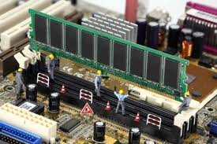
Vertical Scaling
Caveat: Individual computers can still suffer from limited resources with respect to the scale of today’s problems
Caches and Memory:
L1
Cache
L2 Cache
L3 Cache
Main Memory
16-32 KB/Core, 4-5 cycles
128-256 KB/Core, 12-15 cycles
512KB- 2 MB/Core, 30-50 cycles
8GB- 128GB, 300+ cycles

Slide 10
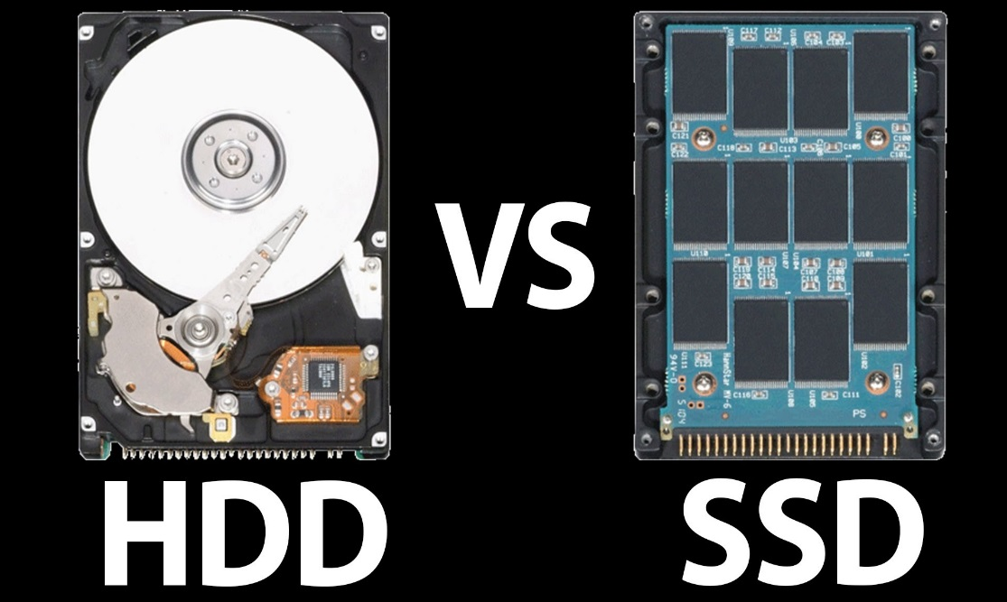
Vertical Scaling
Caveat: Individual computers can still suffer from limited resources with respect to the scale of today’s problems
Disks-- some advancements, but still:
Limited capacity
Limited number of channels
Limited bandwidth

Slide 11
Vertical Scaling
Caveat: Individual computers can still suffer from limited resources with respect to the scale of today’s problems
Processors:
Moore’s law still holds
Chip Multiprocessors (CMPs) are now available
P
P
P
P
P
L1
L1
L1
L1
L1
Interconnect
L2
L2 Cache
A single Processor Chip
A CMP
Notes:
- Moore’s law states that the number of transistors that can be placed in a processor will double approximately every two years, for half the cost.

Slide 12
Vertical Scaling
Caveat: Individual computers can still suffer from limited resources with respect to the scale of today’s problems
Processors:
But up until a few years ago, CPU speed grew at the rate of 55% annually, while the memory speed grew at the rate of only 7%
P
Processor-Memory speed gap
M
Notes:
- Moore’s law states that the number of transistors that can be placed in a processor will double approximately every two years, for half the cost.

Slide 13
Vertical Scaling
Caveat: Individual computers can still suffer from limited resources with respect to the scale of today’s problems
Processors:
But up until a few years ago, CPU speed grew at the rate of 55% annually, while the memory speed grew at the rate of only 7%
Even if 100s or 1000s of cores are placed on a CMP, it is a challenge to deliver input data to these cores fast enough for processing
Notes:
- Moore’s law states that the number of transistors that can be placed in a processor will double approximately every two years, for half the cost.

Slide 14
Vertical Scaling
10000 seconds (or 3 hours) to load data
P
P
P
P
L1
L1
L1
L1
Interconnect
A Data Set
of 4 TBs
L2 Cache
Memory
4 100MB/S IO Channels

Slide 15
How to Store and Process Data at Scale?
A system can be scaled:
Either vertically (or up)
Can be achieved by hardware upgrades (e.g., faster CPU, more memory, and/or larger disk)
And/Or horizontally (or out)
Can be achieved by adding more machines

Slide 16
Horizontal Scaling
Only 3 minutes to load data
P
100
Machines
P
Splits
L1
L1
L2
L2
Memory
Memory
A Data Set (data)
of 4 TBs

Slide 17
Requirements
But, this necessitates:
A way to express the problem in terms of parallel processes and execute them on different machines (Programming and Concurrency Models)
A way to organize processes (Architectures)
A way for distributed processes to exchange information (Communication Paradigms)
A way to locate and share resources (Naming Protocols)
Notes:
- Moore’s law states that the number of transistors that can be placed in a processor will double approximately every two years, for half the cost.

Slide 18
Requirements
But, this necessitates:
A way for distributed processes to cooperate, synchronize with one another, and agree on shared values (Synchronization)
A way to reduce latency, enhance reliability, and improve performance (Caching, Replication, and Consistency)
A way to enhance load scalability, reduce diversity across heterogeneous systems, and provide a high degree of portability and flexibility (Virtualization)
A way to recover from partial failures (Fault Tolerance)
Notes:
- Moore’s law states that the number of transistors that can be placed in a processor will double approximately every two years, for half the cost.

Slide 19
So, What is a Distributed System?
A distributed system is:
A collection of independent computers that appear to its users as a single coherent system
One in which components located at networked computers communicate and coordinate their actions only by passing messages

Slide 20
Features
Distributed Systems imply four main features:
1
Geographical Separation
2
No Common Physical Clock
No Common Physical Memory
3
4
Autonomy and Heterogeneity

Slide 21
Parallel vs. Distributed Systems
Distributed systems contrast with parallel systems, which entail:
1
Strong Coupling
2
A Common Physical Clock
A Shared Physical Memory
3
4
Homogeneity

Slide 22
Some Administrivia!
Notes:
- Moore’s law states that the number of transistors that can be placed in a processor will double approximately every two years, for half the cost.

Slide 23
Introduction to Distributed Systems
Considered: a reasonably critical and
comprehensive perspective.
Thoughtful: Fluent, flexible and efficient
perspective.
Masterful: a powerful and illuminating
perspective.
.9. Fault Tolerance (2 Lectures)
.8. Distributed Frameworks (5 Lectures)
.7. Replication (3 Lectures)
.6. Caching (3 Lectures)
.5. Synchronization (4 Lectures)
.4. Naming (2 Lectures)
.3. Remote Procedure Calls (3 Lectures)
.2. Architectures (1 Lecture)
.1. Networks (2 Lectures)
.0. Introduction (1 Lecture)

Slide 24
Course Objectives
The course aims at providing an in-depth understanding and hands-on experience on
How modern distributed systems meet the demands of contemporary distributed applications
Distributed system programming models and analytics engines
Principles on which distributed systems are optimized
Principles on which distributed systems are based

Slide 25
Assessment Methods
How do we measure learning?
To pass the course, you need to pass the hands-on (i.e., projects) and the theory components
Type | # | Weight
Project | 4 | 40%
Exam | 2 | 30% (Midterm: 10% & Final: 20%)
Problem Set | 5 or 6 | 15%
Quiz | 2 | 10%
Attendance & Participation | 40 | 5%

Slide 26
Rules on the Projects
For all the projects except the final one, the following rules apply:
If you submit one day late, 25% will be deducted from your project score
If you are two days late, 50% will be deducted
The project will not be graded (and you will receive a zero score) if you submit more than two days late
You have a 3-grace-day quota

Slide 27
Next Lecture
Networks- Part I
Questions?

